Slide 1


Antonio Cardona
Nathan Finley
Nicole LoGiudice
Final Presentation
GrAPE (Graphic Analog Portable Equalizer)
Team #6
Notes:
template slide

Slide 2
Project Overview
Problem Statement
The current market lacks audio equalizers that offer both Bluetooth input and output connectivity.
Solution Proposal
The GrAPE, a graphic analog portable equalizer that has features:
Reception/transmission of Bluetooth
Can toggle inputs and outputs between bluetooth and auxiliary
Ten tunable frequency bands that span the human hearing range (design: 20-20kHz, with extended frequencies present)
Display
Onboard power
Portability
Notes:
template slide

Slide 3
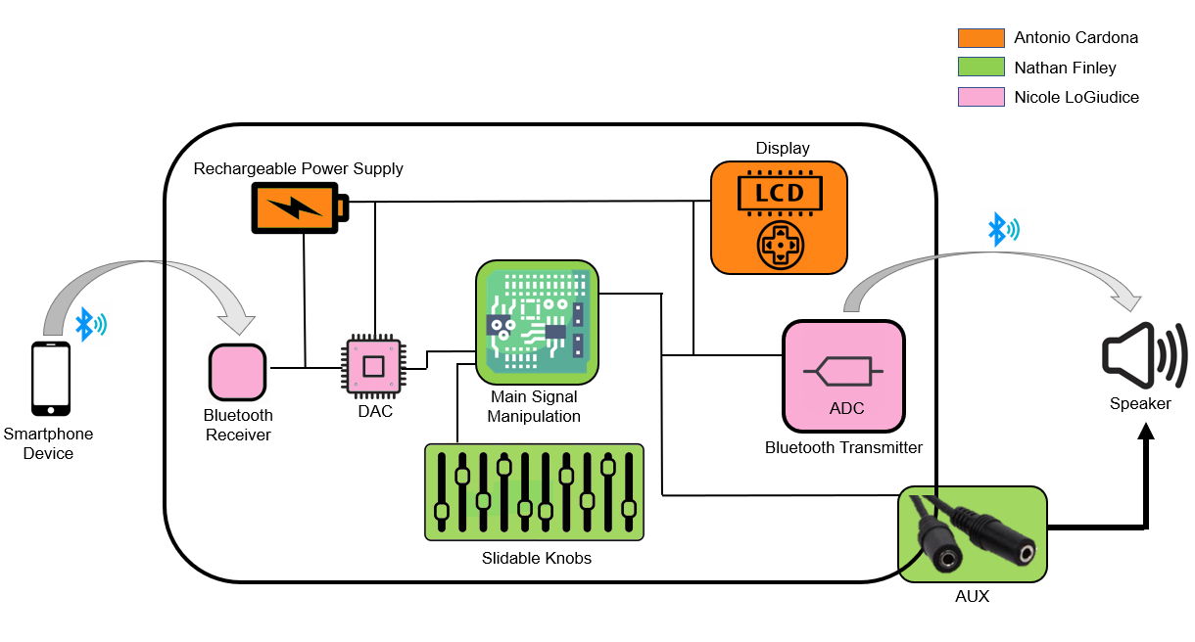
System Overview
Notes:
Would the LCD display have to be connected to the Bluetooth transmitter?

Slide 4
Subsystem Partition
Antonio Cardona: “Design power supply system and develop user interface including a display and an user-controlled menu to allow Bluetooth connectivity.”
Nathan Finley: “Design audio signal manipulation PCB with input from DAC and output to ADC and auxiliary that take control inputs from at least 10 frequency sliders.”
Nicole LoGiudice: “Design bluetooth input and output system while also converting the signal from analog to digital or digital to analog as needed.”
Notes:
template slide

Slide 5
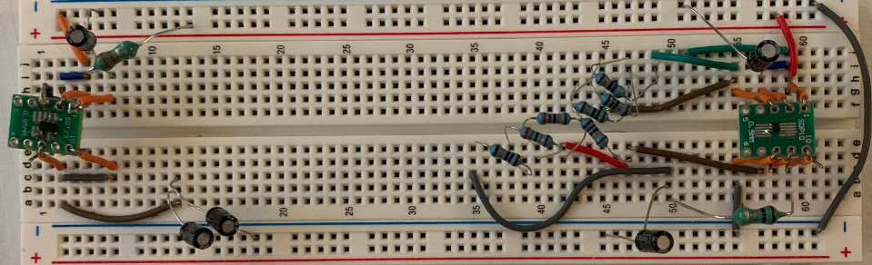
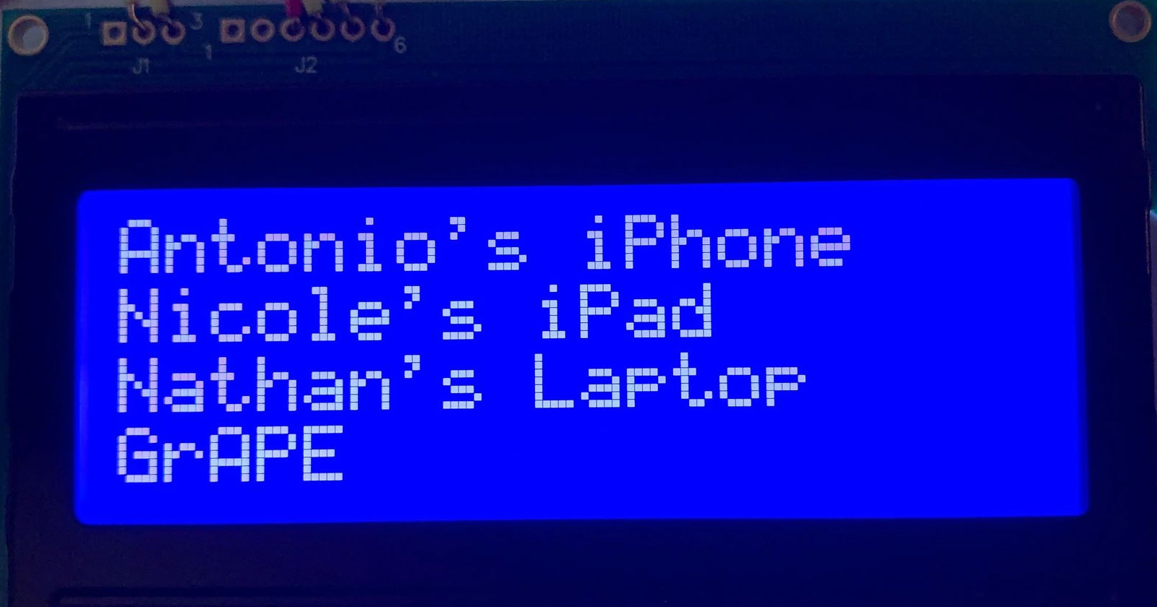
Design Accomplishments
Power Supply and LCD Subsystem
Power Supply Subsystem
Schematic design completed
PCB design near completion
DC-DC converters being tested
LCD Subsystem
Takes array input and successfully shows the receivers in the array and user is able to select a receiver which sends a string to the terminal
Boost Converter (Left) and Buck Converter (Right)
FSR Task | Name Task | Status
3.2.1.7 | Display Integration | IN PROGRESS
3.2.3.1.1 | Power Consumption | IN PROGRESS
3.2.3.1.2 | Input Voltage (Subsystems) | IN PROGRESS
LCD Displaying Receivers
Notes:
Add pictures of ordered parts.

Slide 6
Remaining Tasks
Power Supply and LCD Subsystem
Power Supply Subsystem
PCB designed and ordered
Charging circuit tested including “Battery Percentage” and “Battery Operating Time” tasks from FSR.
Complete IN PROGRESS tasks
Integrate power supply subsystem with other subsystems
LCD Subsystem
Complete code for UP, DOWN, and SELECT buttons
Allow more than 4 receivers to be displayed by implementing a scroll down menu
Integrate with Nicole’s Subsystem
FSR Task | Name Task | Status
3.2.1.10 | Battery Percentage | UNTESTED
3.2.1.11 | Battery Operating Time | UNTESTED
3.2.1..7 | Display Integration | UNTESTED
Notes:
Add pictures of ordered parts.

Slide 7
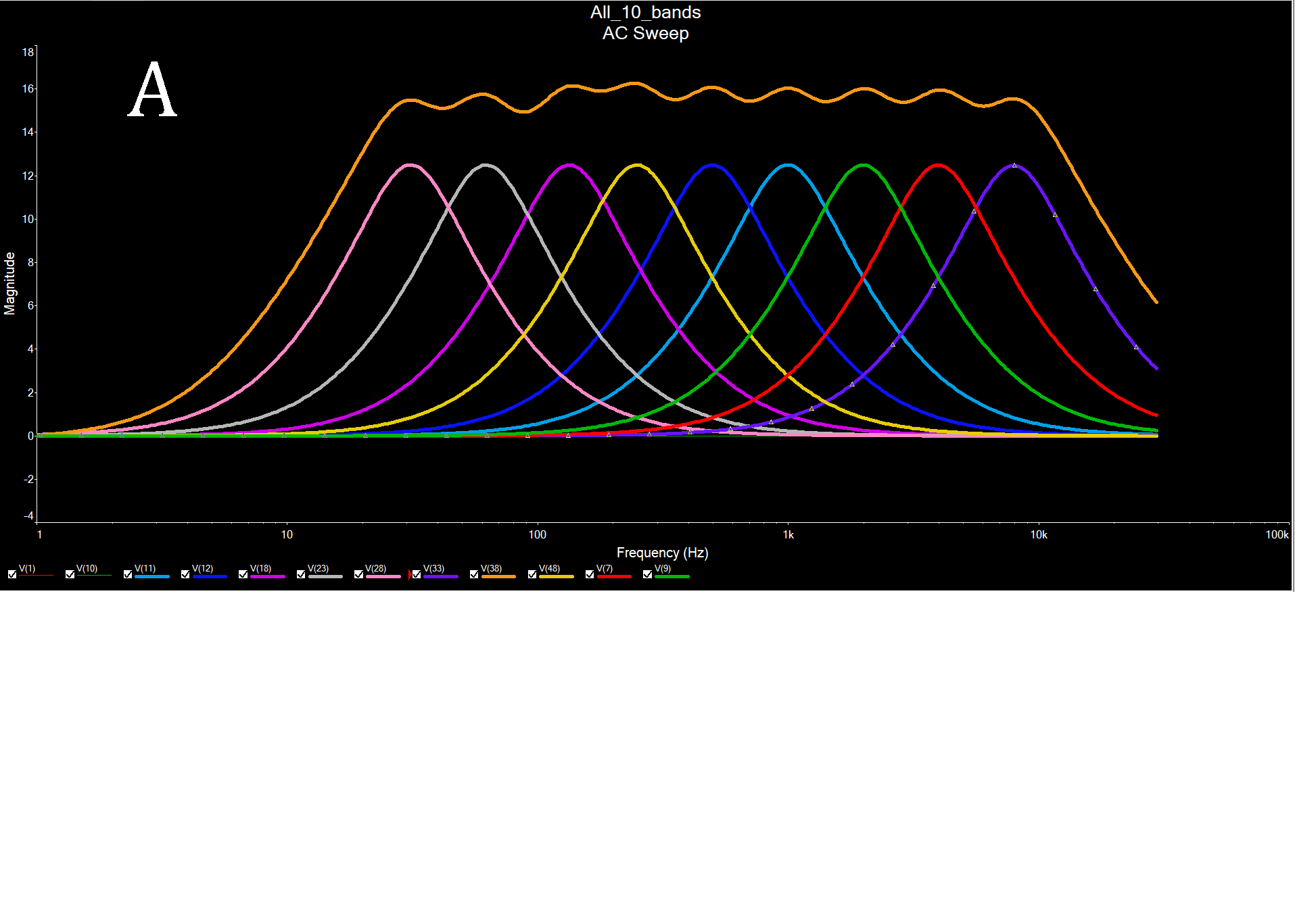
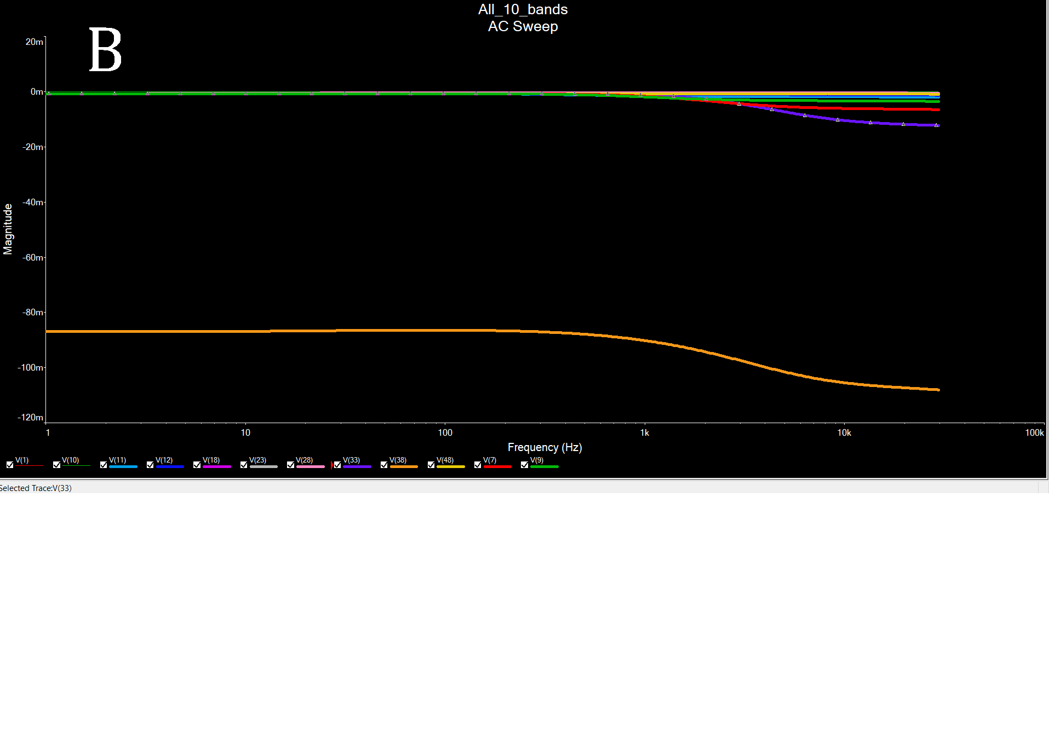
Equalizer Subsystem - Sem. 1 Deliverables
Simulation Results
Full system voltage transfer 0-30kHz, potentiometers tuned to 100% [A]
Full system voltage transfer, potentiometers tuned to 50% [B]
Approximate gain per band: 16.25 dB

Slide 8
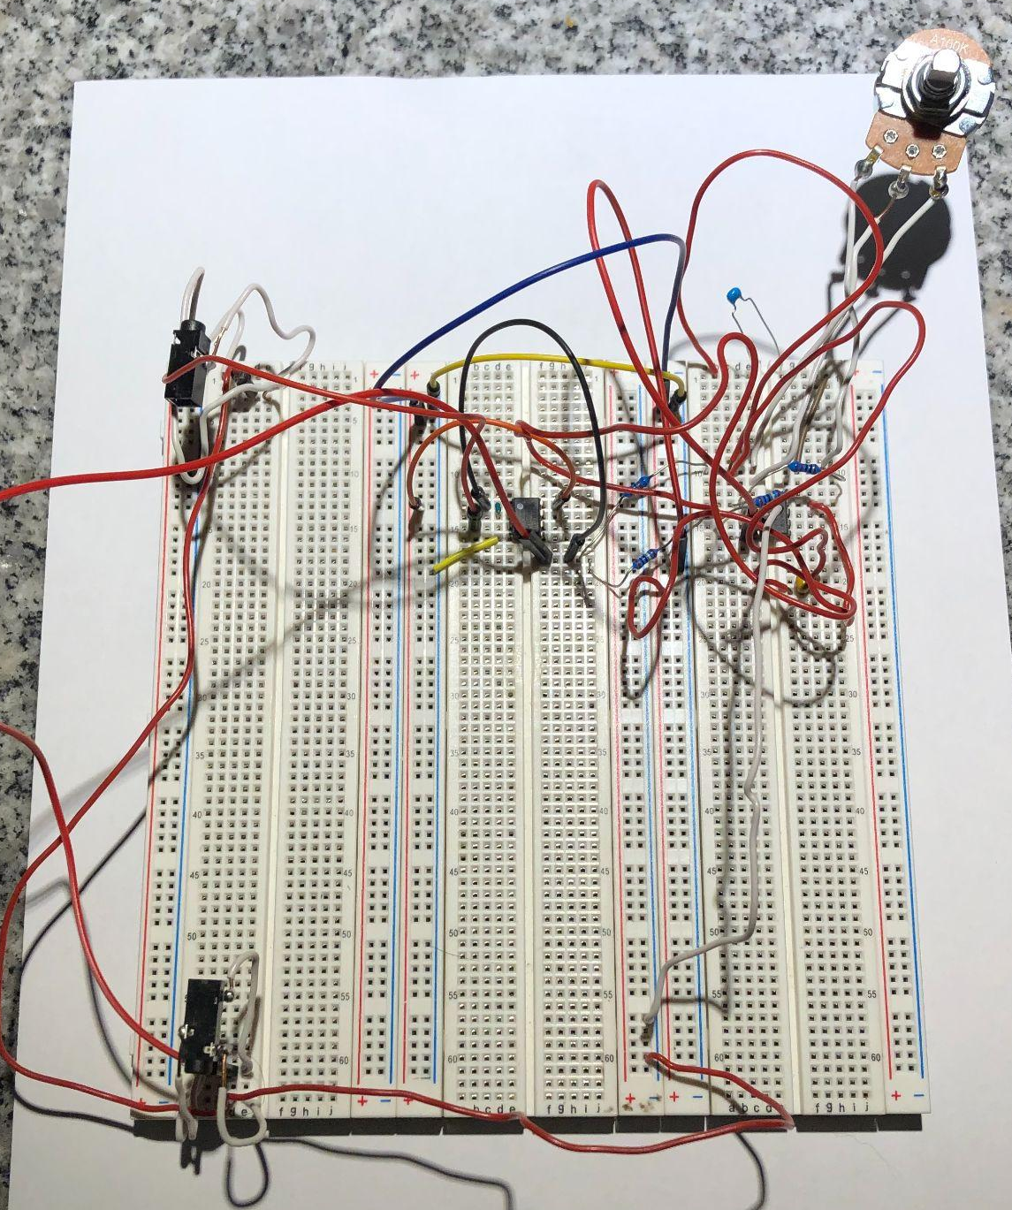
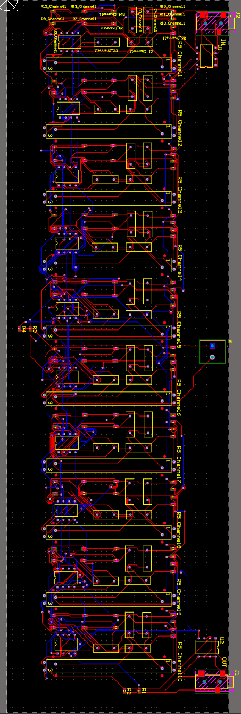
Equalizer Subsystem -
Sem. 1 Deliverables
Implementation
Test of 31 Hz, 500 Hz, and 16000 Hz bands
Successful Indicator: the bands can amplify the isolated frequencies individually to a significant magnitude, and cut the same voltages accordingly.
Result: Failed
Reasoning: Human error in wiring or hardware quality (breadboard/circuit components)
PCB
Successful indicator: Fully-placed and fully-routed PCB with no DRC errors or with allowable DRC errors
Result: Passed
Present errors: silk to solder mask clearance errors

Slide 9
Bluetooth Input/Output Connectivity Subsystem
Testing Completed:
Connectivity Distance
51 ft
Connectivity Duration
Did not drop for the testing time of 5 minutes
Connectivity Reliability
Connects 5 out of 5 times

Slide 10
Bluetooth Input/Output Connectivity Subsystem
12-15 hours Weekly
Completed | Troubleshooting/Next Steps for 404
Receiver and transmitter Schematics and PCBs | Volume controls are buggy
Receiver and Transmitter Code work | Displaying/transmitting available receivers all together

Slide 11
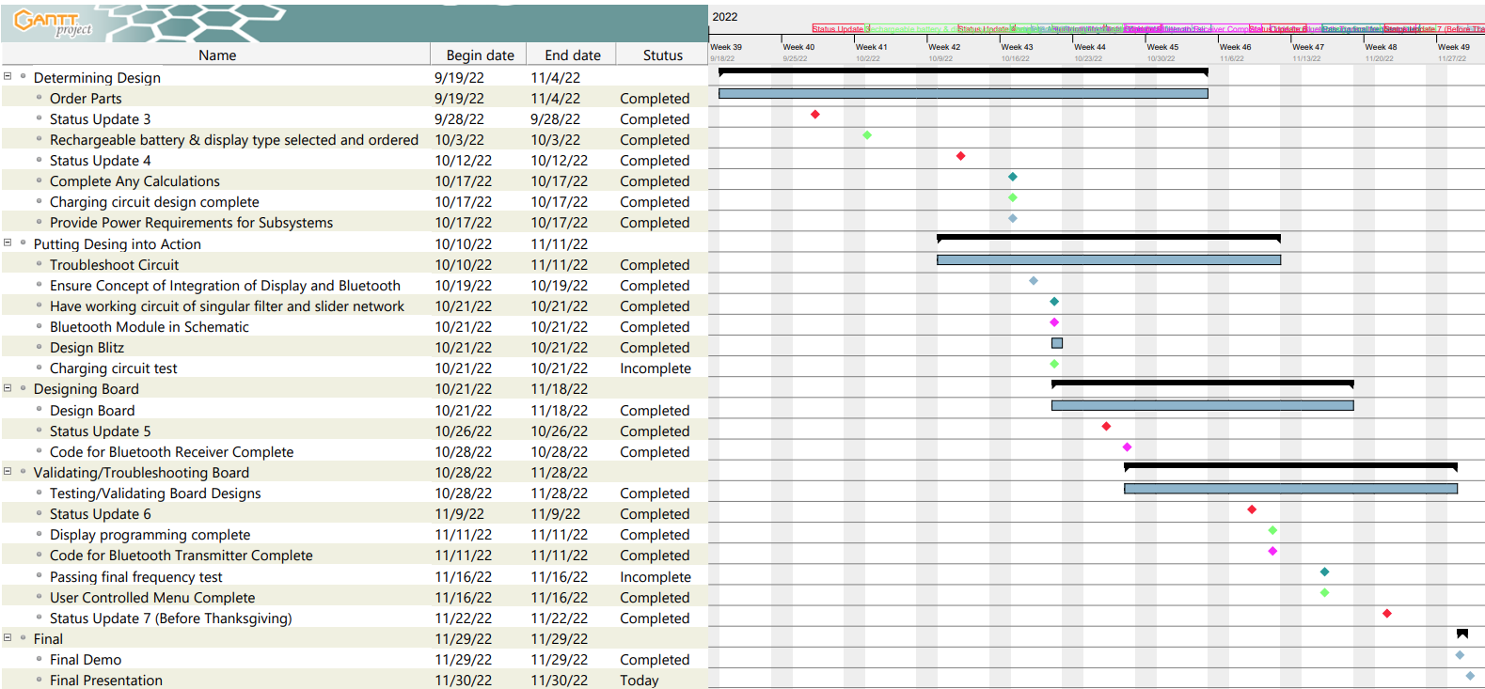





Execution Plan
Status Updates
Antonio
Nathan
Nicole
General Team
Notes:
We get shit done
factz

Slide 12
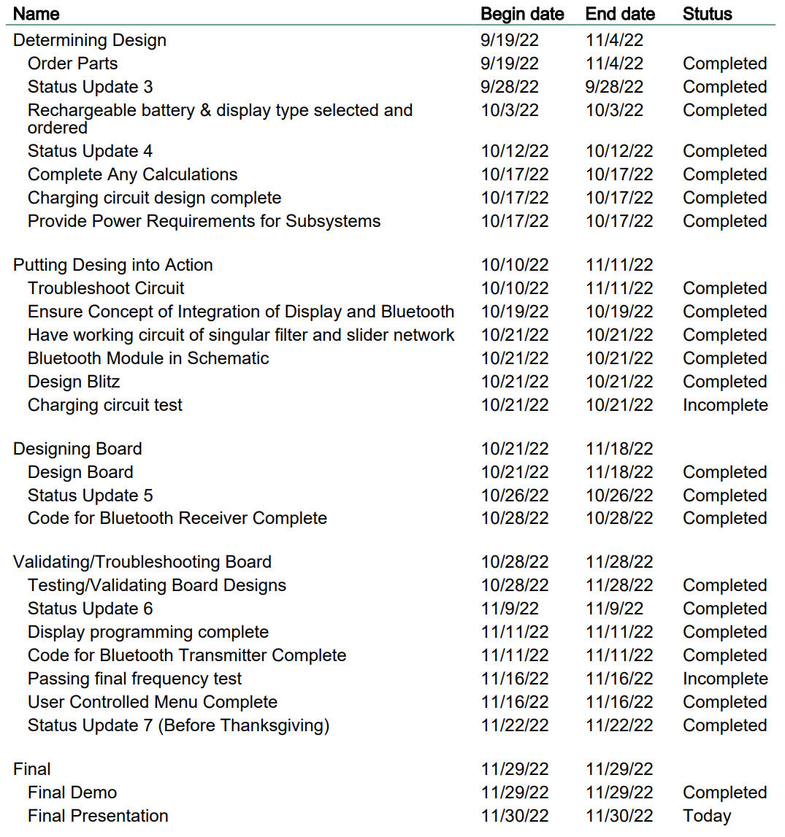
Execution Plan Total
Notes:
We get shit done
factz

Slide 13
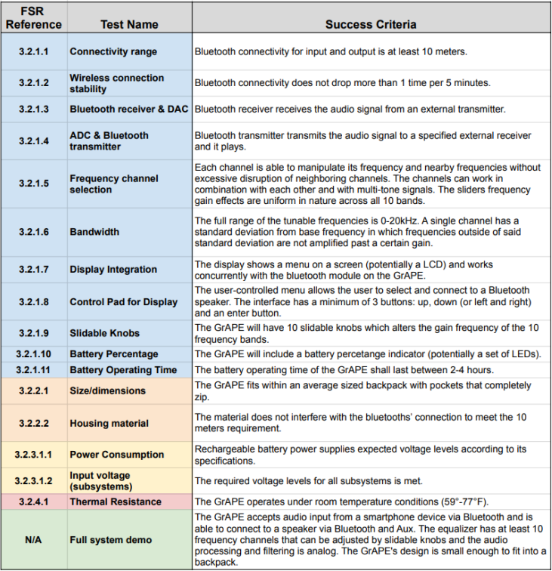
Validation Plan Part 1
Design
Physical
Power
Demo
Notes:
EDIT needed
Also, once this is finished I will take a screenshot of it and size it down to fit into the slide! :)

Slide 14
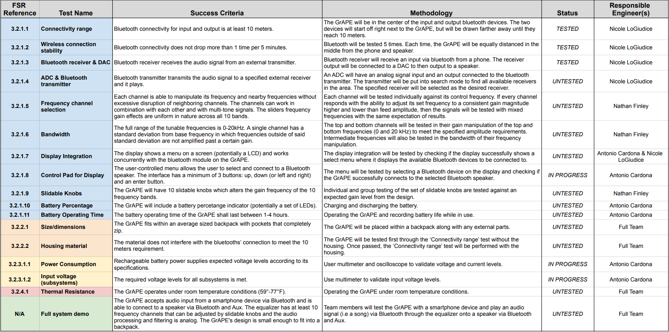
Validation Plan Part 2
Notes:
EDIT needed
Also, once this is finished I will take a screenshot of it and size it down to fit into the slide! :)

Slide 15
ECEN 404 Tasks
Antonio
PCB ordered, validated and integrated with the other subsystems
Complete LCD code for integration with Bluetooth Modules
Nathan
Housing for project
PCB ordered, optimized
Add LED indicator light for power to system
Integration
Nicole
PCB: final designs and implementation
Smooth out bugs in code
Transmit array of available receivers

Slide 16
Any Questions?

